Slide 1
Marketing
MARKETING OVERVIEW

Slide 2
CONTENT & CAMPAIGNS

Slide 3
Branding & Thought Leadership
“Share of Voice” in Market
Google Search results
Leadership / Expertise
Industry Pickups (Associations, Magazines, Blogs)
Content to share with Clients
Drive utilization
Develop thought leadership
Content to share with Leads
Share with social networks
Mention in sales calls to support sales process

Slide 4
Sales Campaigns

Slide 5
Customer Campaigns

Slide 6
Partner Co-Branded Campaigns

Slide 7
Product Campaigns

Slide 8
Webinars with Industry Influencers

Slide 9
Blogs
Quarterly: 12 blogs written
by 9 different blog authors
Diverse topics:
Student Housing
Employment/Hiring
Fair Housing Law
Resident/Convergent Billing
Resident Issues
Management Tips
Retention
Driving Payments

Slide 10
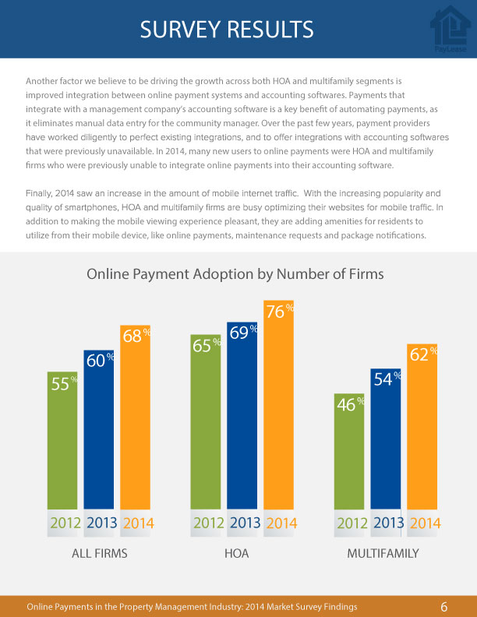
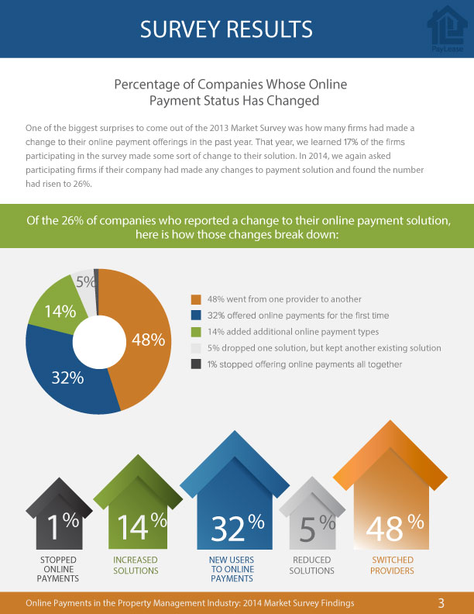
Downloads

Slide 11
Press Releases
Website Reads | PR Web Reads | PR Web Pick Ups
92 | 1765 | 263
Website Reads | PR Web Reads | PR Web Pick Ups
908 | 2052 | 252

Slide 12
Awards

Slide 13
SOCIAL MEDIA

Slide 14
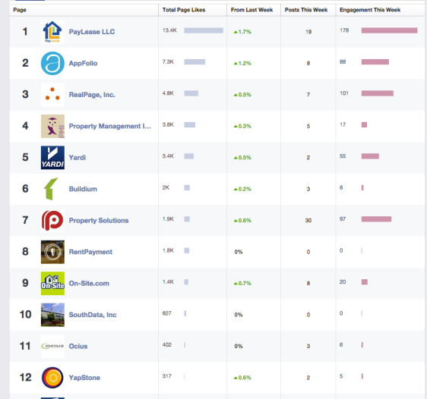
Facebook Ranking

Slide 15
Online Reviews
578
2014: 15 Online Reviews

Slide 16
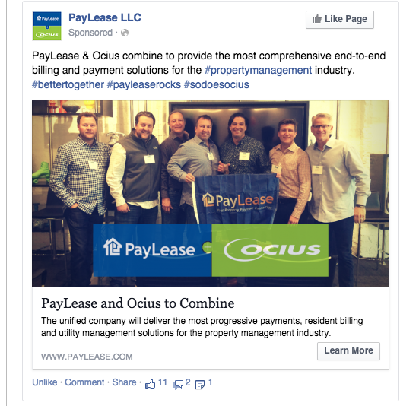
Significant Facebook Ads
Total Reach | Website Clicks
44,926 | 376
Total Reach | Website Clicks
53,379 | 600
Total Reach | Website Clicks
27,100 | 13

Slide 17
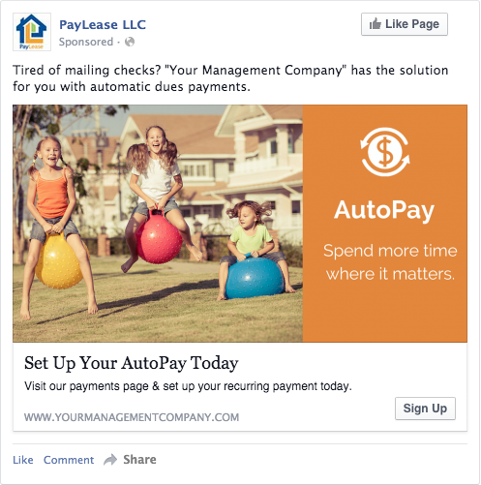
Resident Payment Ads

Slide 18
FIELD MARKETING

Slide 19
70+ Tradeshows & Events Annually

Slide 20
Large Exibition Goals & Results
Booth Design
Customer Party
Facebook Advertising
Panel Session
Booth Contest
Email Campaigns
Influencer Participation
Partner Co-Marketing
50+ Engaged Leads
800+ Attendees
50,000+ Reached
120+ Attendees
200+ Participants
8,000 Emails Sent to Leads & Clients

Slide 21
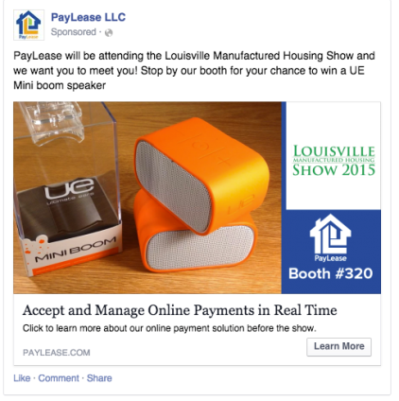
Pre-Tradeshow Promotion

Slide 22
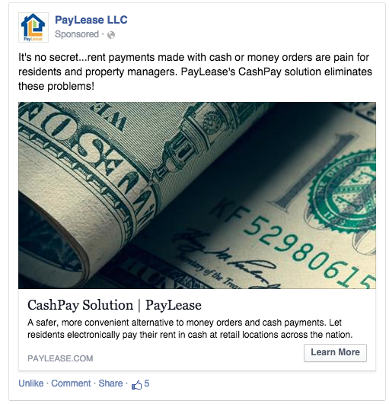
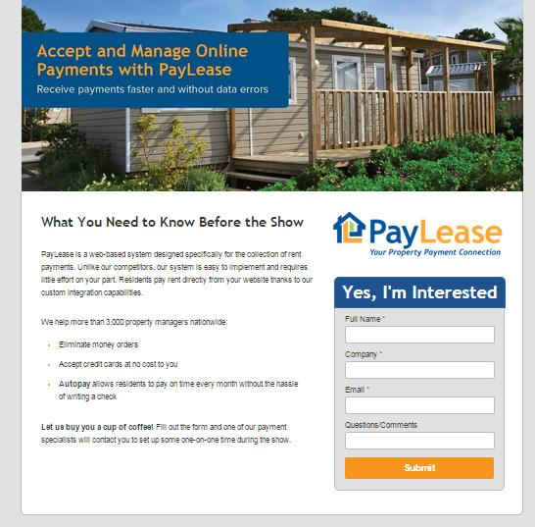
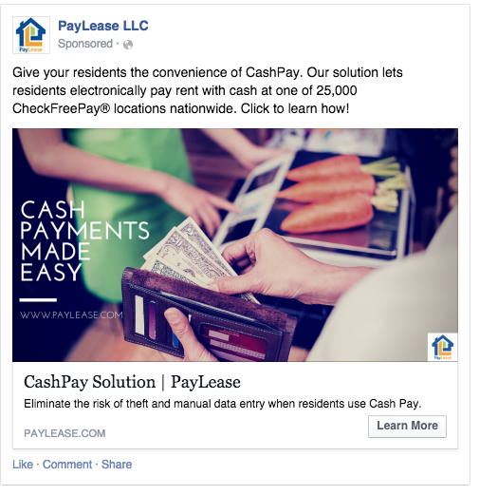
Post-Tradeshow Promotion

Slide 23
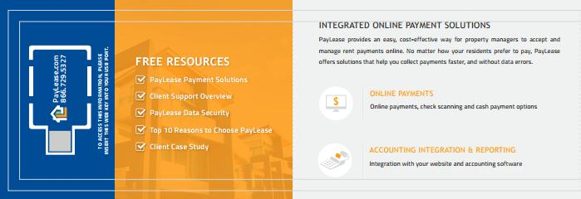
Sales & Customer Aids
Notes:
Franklin Management – Cash Pay Case Study
HCA – AMSI Integration / Student Housing Case Study
Perrel Management Company - 1800 multifamily client using Property Boss
Came to PayLease from another provider (PayPros); Focus is on our pricing and reporting features

Slide 24
Resident-Focused Print Materials
Customizable printed marketing materials provided to property managers to help promote online payments.
Inserts
Door Hangers
Inserts

Slide 25
Resident-Focused Email Campaigns
Customizable email campaign templates to promote online payments to residents.

Slide 26
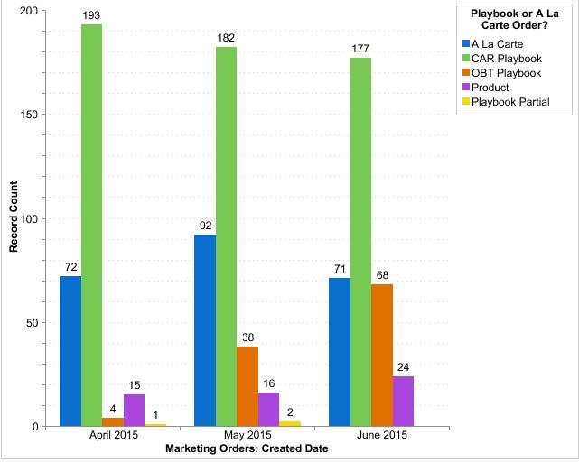
Print Order Fulfillment
Over 1,000 Playbooks Created per Quarter

Slide 27
Email Campaign Fulfillment

Slide 28
WEB DEVELOPMENT

Slide 29
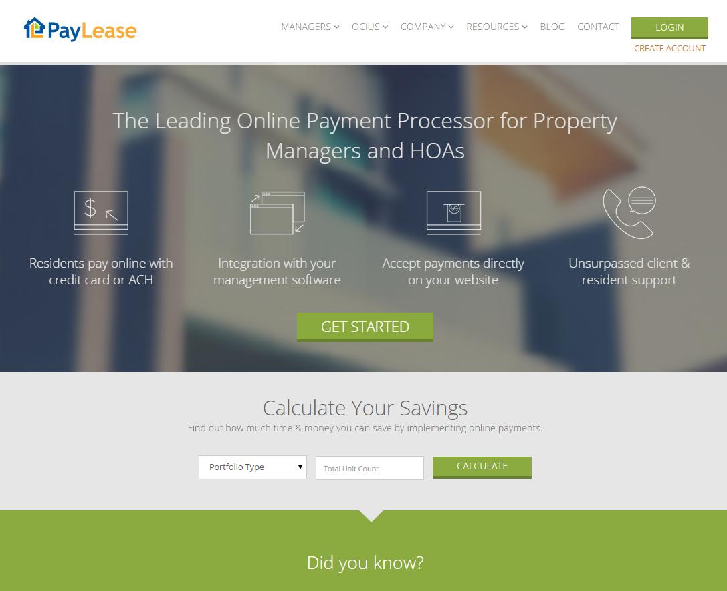
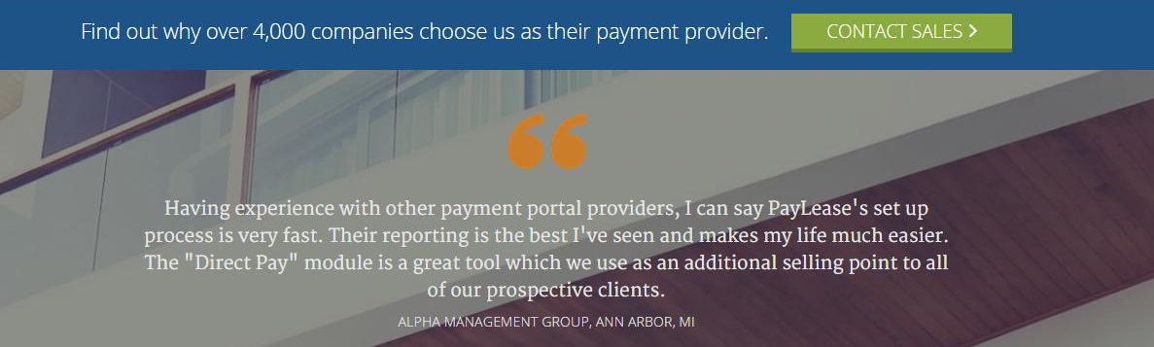
Website Performance YTD
399 Downloads
193 PMs / 48% Conversion
19 Calculator Submissions
8 Converted Leads / 42% Conversion
230 Contact Us Forms
107 Opps Created / 46% Conversion
90,416 units added to pipeline
Notes:
Contact Us Form - YTD Inbound Forms - 230 Viable Leads / 107 Opps Created (90,416 units added to pipeline, average 845 units per opp)
ROI Calculator - YTD 19 Viable Lead Submissions (42% Conversion Rate) / Resulted in 8 converted leads (5,570 units added to pipeline, 696 units average)
Downloads – YTD 399 Downloads (193 PMs / 48.4% Conversion rate)

Slide 30
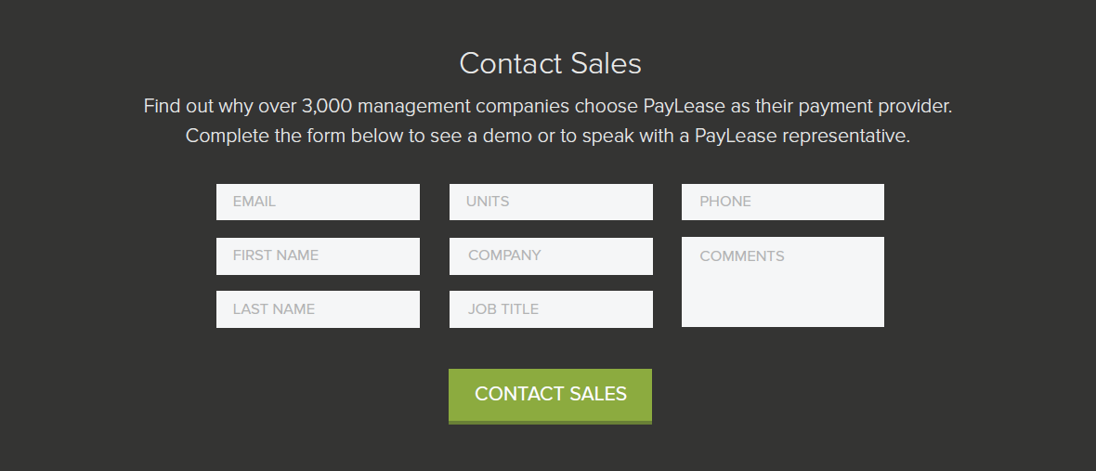
Website Redesign: Lead Generation

Slide 31
Website Redesign: Enhanced Blog

Slide 32
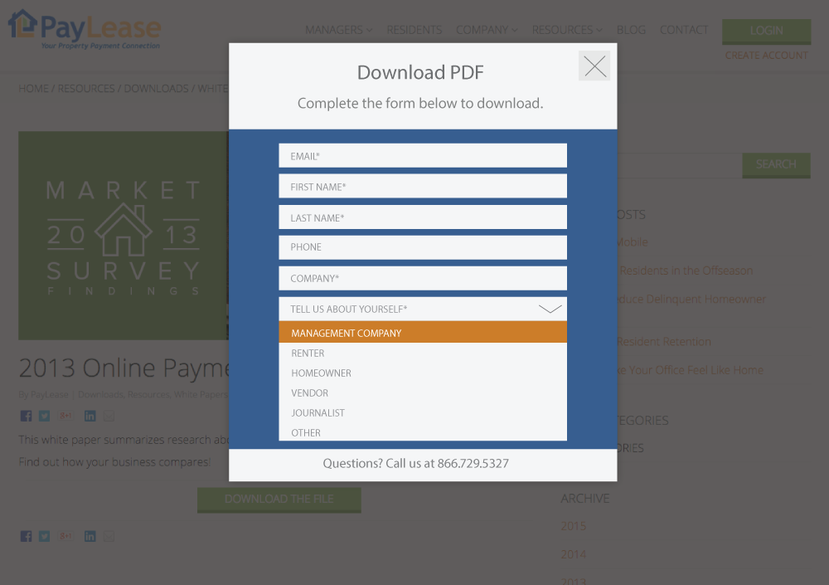
Website Redesign: Marketo Form

